Slide 1
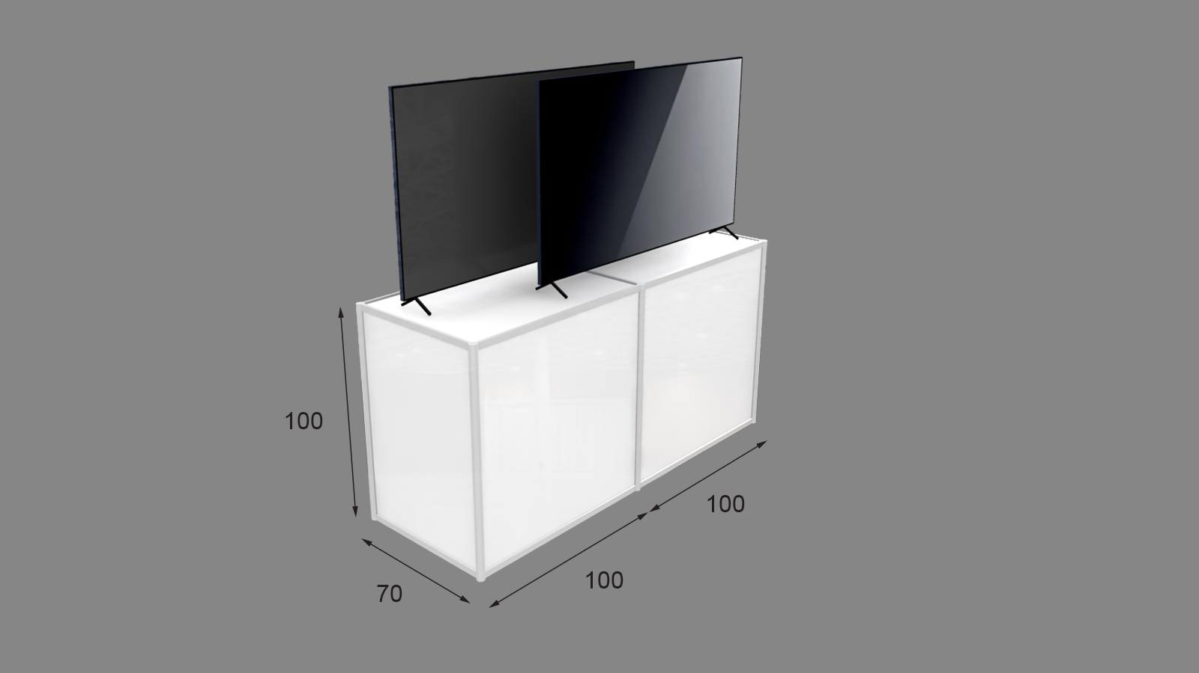
Title
Flash Text
E-Poster
Introduction
Select the text of interest
Go to “Animations” Toolbar → Roll down to Select “Pulse” → Open Animation Pane → Click on Downward Triangle → Select “Timing …” → Set “Repeat” to “Until End of Slide”
This is a basic template for illustration purpose. You should design your own content.
E-poster (screen) size: 142.24cm W x 80.01cm H (56” x 31.5”)
Go to “Design” Toolbar → Select “Slide Size” → Select “ Custom Slide Size” → Set 142.24cm W x 80.01cm H (56” x 31.5”)
LED screen aspect ratio: 16:9
Only landscape orientation
Recommended minimum font size: 42 points
Only one page for each e-poster
Attention
Embedded media (video) can only be displayed in the following formats: .mov, .mp4, .mpeg.
Place your video file along with your PowerPoint file.
If you want to embed online video, ensure the availability of the internet or Wi-Fi network connection
Embed Video
Embed video in your poster
Go to “Insert” Toolbar → Select “Video” → Select “Video on my PC …”
Keep video running throughout the entire e-poster session
Go to “Slide Show” Toolbar → Select “Set Up Slide Show” → Check “Loop continuously until Esc”
Alternatively, Click on the video → Go to “Video Tools / Playback” → Select “Loop until Stopped”
Animation Graphics
You may display GIF graphics too
Conclusion
Bullet 1
Bullet 2
Bullet 3
Bullet 4

